Slide 1


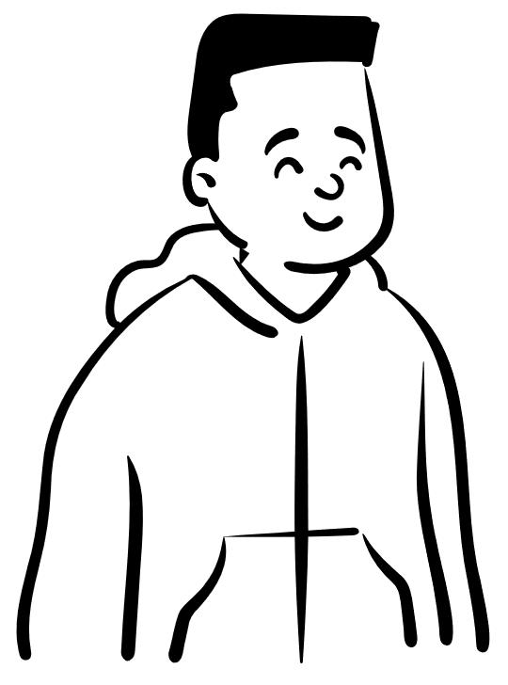
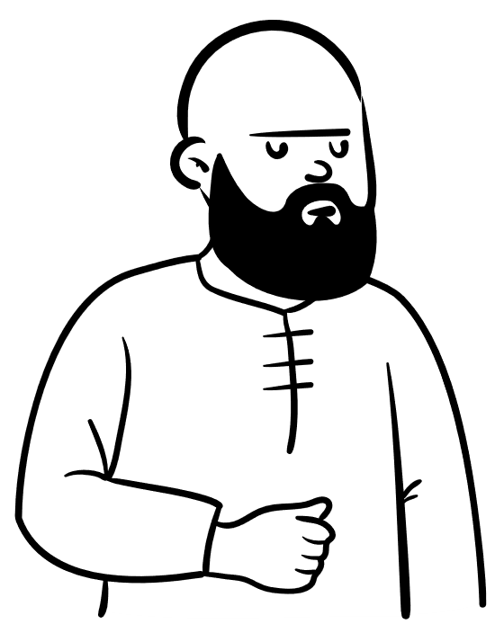



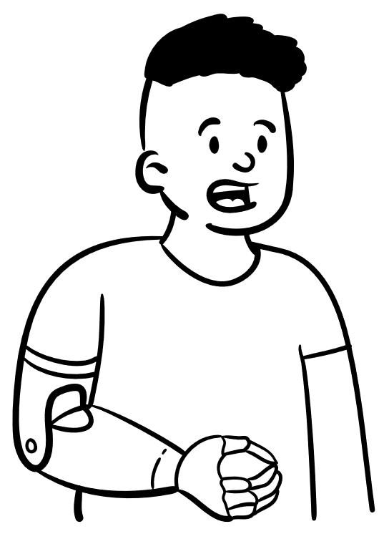

EVOLUTION OF ROLES WITH
MICROSOFT FABRIC
Scaling from a single person to an
Enterprise Organization

Slide 2



Increased Overlap Between Business and IT
IT
BUSINESS

Slide 3


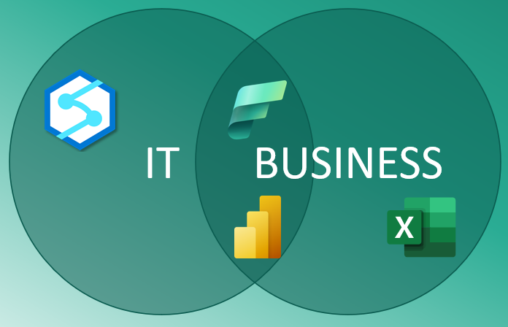
Small BI Shops wear many hats
Presenter
Business
Analyst
IT Admin
Data
Analyst
Data
Modeler
Support
Report
Author
Evangelist

Slide 4
Fabric Introduces Data Engineering
and Data Science
Data
Engineer
Data
Scientist
Presenter
Business
Analyst
IT Admin
Data
Analyst
Data
Modeler
Support
Report
Author
Evangelist

Slide 5
Key player risk is a significant challenge
Presenter
Business
Analyst
Support
Data
Analyst
Data
Scientist
IT Admin
Data
Engineer
Data
Modeler
Evangelist
Report
Author

Slide 6
Growth to IT and Domain / Business
IT
Domain
Data
Engineer
Data
Modeler
Presenter
BI Product
IT Admin
Business
Analyst
Report
Author
Data
Analyst
Support

Slide 7
Diversification of Skills
Data
Scientist
Data
Modeler
Data
Engineer
Report
Author
Business
Analyst
Data
Analyst
Support
BI Product
IT Admin

Slide 8
Enterprise Domain Organization
IT
Support
Governance
BI Product
Architect
IT Admin
Data
Scientist
Domain
Data
Modeler
Report
Author
Data
Analyst
Data
Engineer
Business
Analyst

Slide 9









Fabric
Fridays
#11
presented by Chris Wagner,
Kevin Arnold,
& Mark Walter
LIVE
7:30 - 8:30 AM

